Slide 1
Nie D, Wang L, Xiang L, et al. Difficulty-aware attention network with confidence learning for medical image segmentation[C]//Proceedings of the AAAI Conference on Artificial Intelligence. 2019, 33: 1085-1092.
2020.3.12
胡敬玉

Slide 2

论文背景

Slide 3
出发点
Training of the network is inclined to be dominated by the easy-to-segment samples.
Deep segmentation networks cannot properly handle the hard-to-segment samples (or regions)

Slide 4
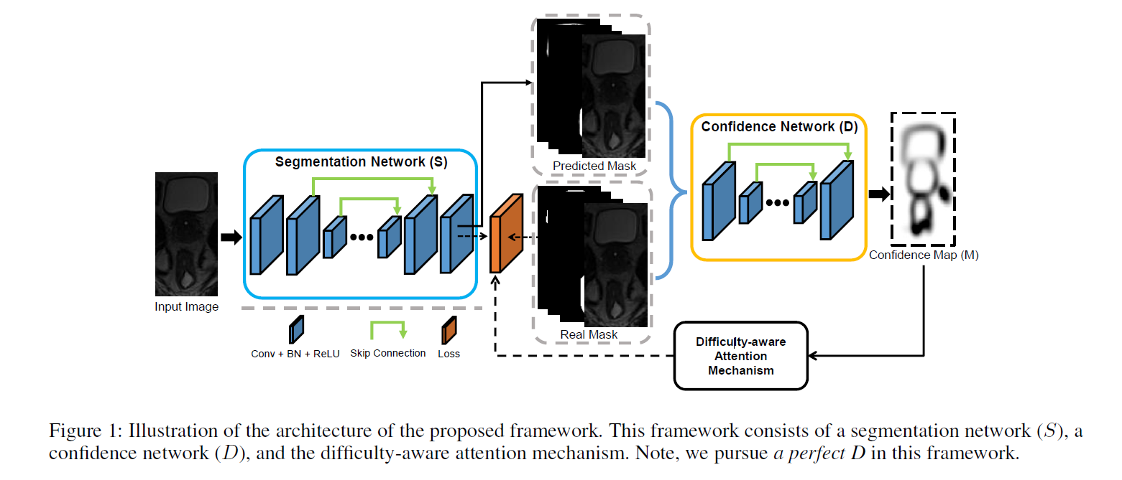

Slide 5
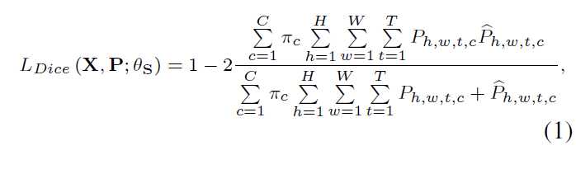
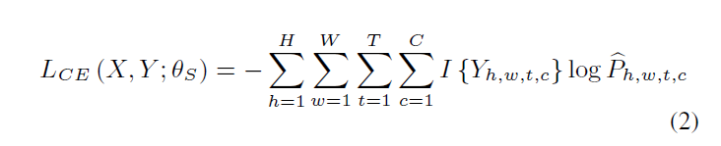

Segmentation Network

Slide 6
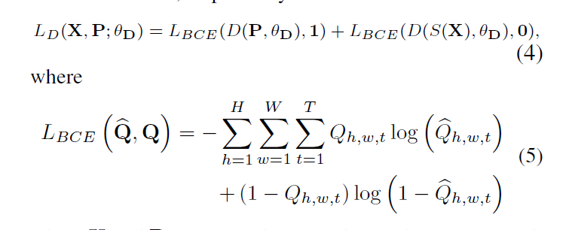

Confidence Network

Slide 7
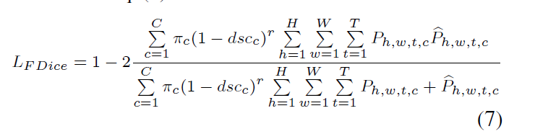
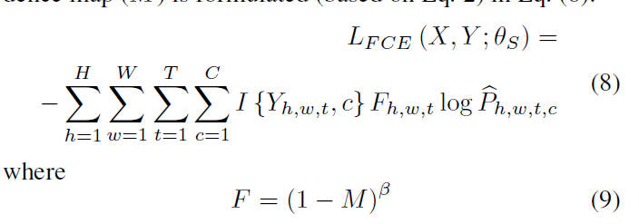
Difficulty-aware Attention

Slide 8


Slide 9
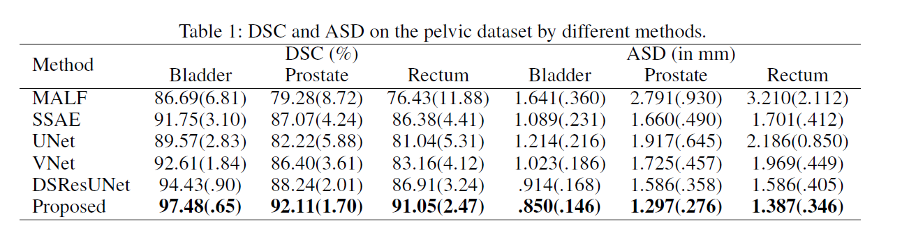
实验

Slide 10
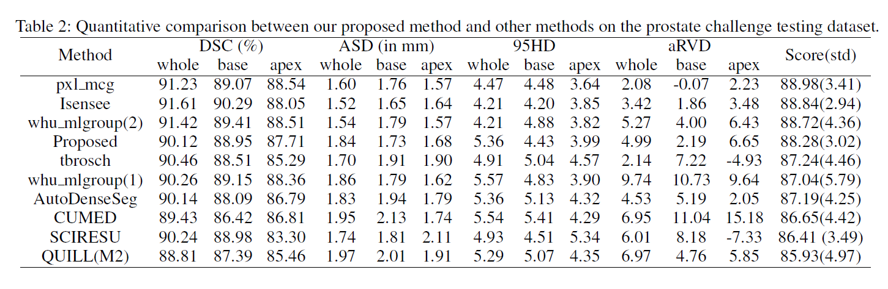
实验

Slide 11
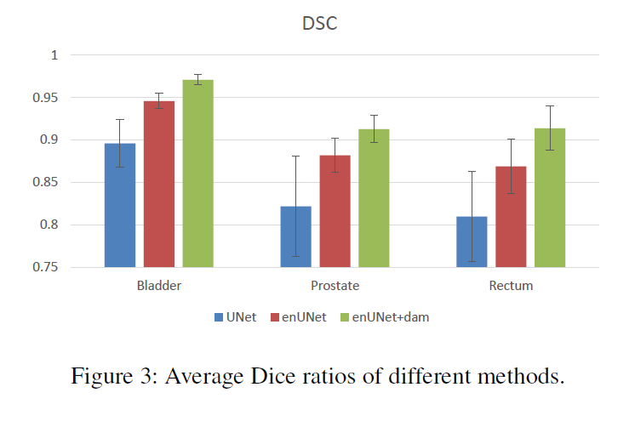
实验

Slide 12
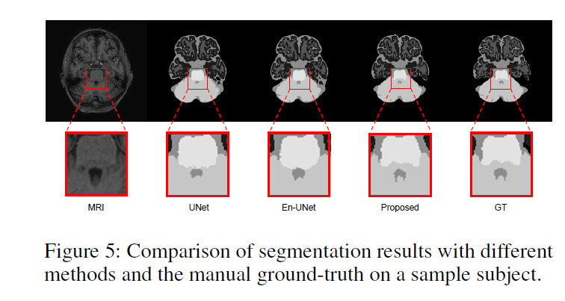
实验

Slide 13
总结
Confidence Network
Difficulty-aware attention mechanism was proposed to effectively address the easy-to segment sample dominance issue in a more structured way.

Slide 14
Thank You!

